Slide 1

Deep Learning Models on Resource-Constrained Hardware: NAS for Tiny Visual Wake Words
18 July 2023
MLDL 2022/2023
307798 Suyash Singh

Slide 2
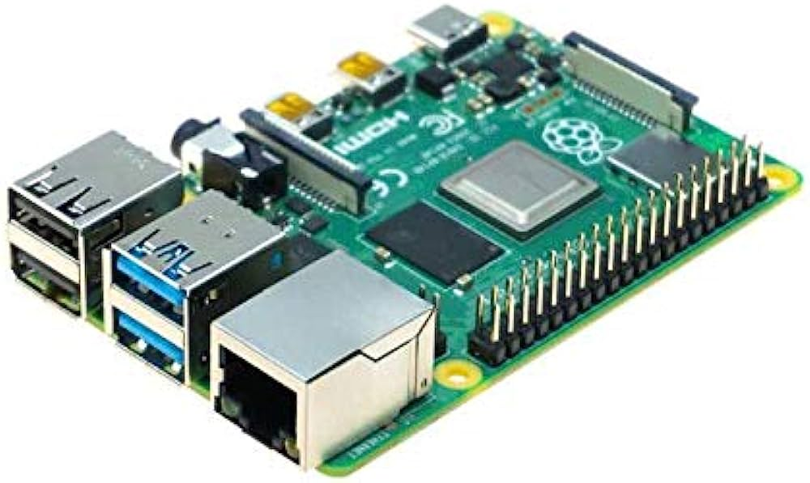
Introduction
TinyML
challenges (e.g. Raspberry Pi)
Our Approach
Optimize the efficiency of DNN
Reducing the number of parameters and FLOPs
Develop a predictive model
Neural Architecture Search (NAS)
Training-free metrics
Enhancing the design process & identifying efficient architectures
Different search strategies

Slide 3

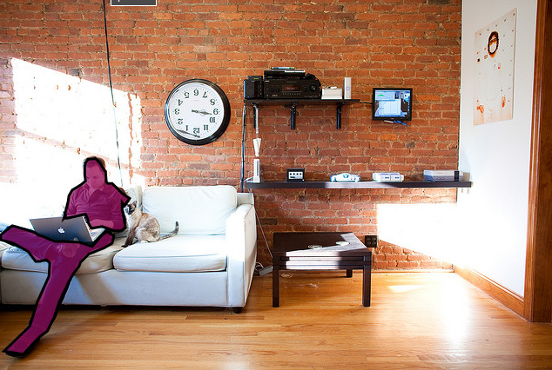
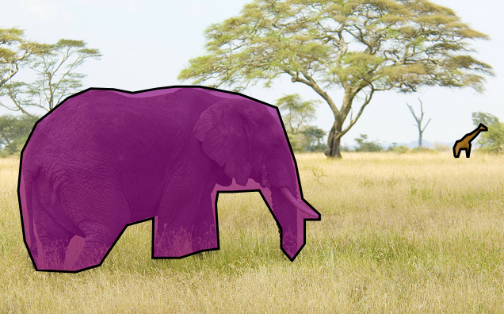

Visual Wake Words Dataset
Designed specifically for vision microcontrollers
Serves as a standardized measure to assess performance
Comprises a dataset of 115,000 training and validation samples
Ideal for devices with constrained computational capabilities
Visual Wake Words label
COCO dataset annotated image
Annotations regarding object of interest
1 “Person”
0 “Not person”

Slide 4
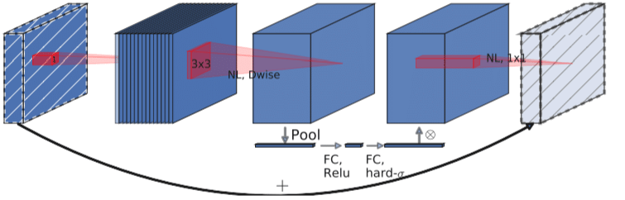
Model Comparison
MobileNetV3
○ Efficient and lightweight CNN.
○ Optimal balance: Accuracy and efficiency.
○ Ideal for resource-constrained devices.
● Models obtained through neural Architecture Search (NAS)
○ Random search algorithm
○ Evolutionary algorithm
MobileNetV3 Architecture

Slide 5
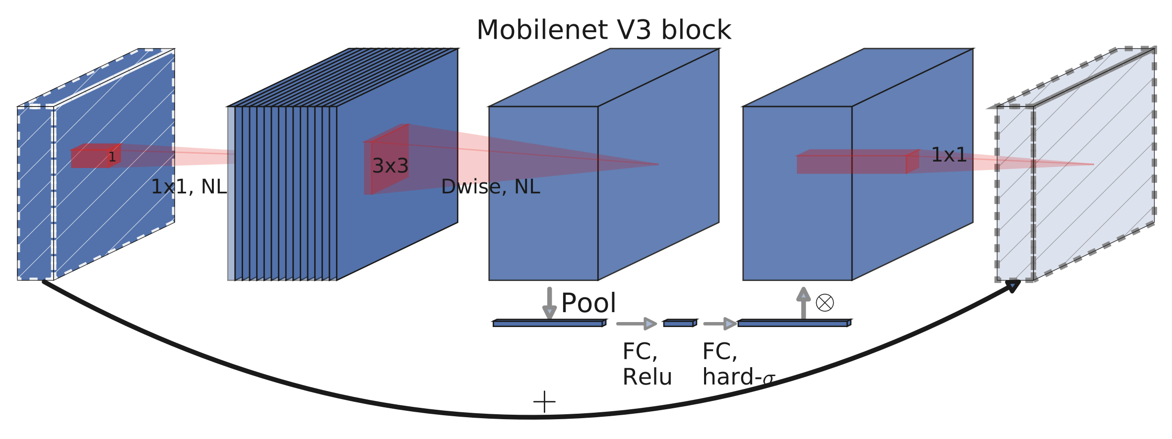
MobileNetV3 Architecture
MobileNetV3 is designed for mobile and embedded devices.
It uses inverted residual blocks to reduce complexity.
The architecture incorporates the Hard Swish activation function for efficiency.
It supports multiple input resolutions and scales for flexibility.
Design choices enhance feature representation and information flow.
MobileNetV3 strikes a balance between efficiency and accuracy.
It is suitable for resource-constrained devices.

Slide 6
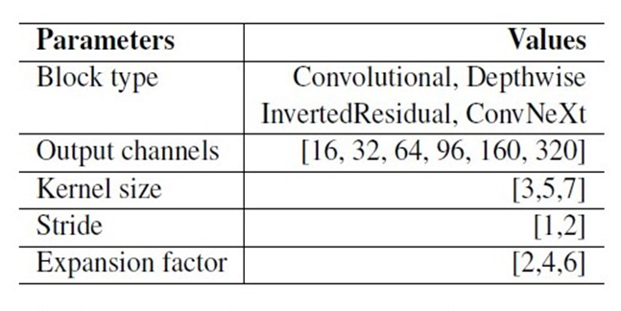
Search Space
Block-based approach
○ Convolutional
○ Depthwise-seperable
○ Inverted residual
○ ConvNeXt
● Parameter exploration
○ output channels, kernel size, stride, expansion factor
● Flexibility
○ Block representation (Network Structure Code (NSC))
○ Network architecture
○ variable-length approach

Slide 7
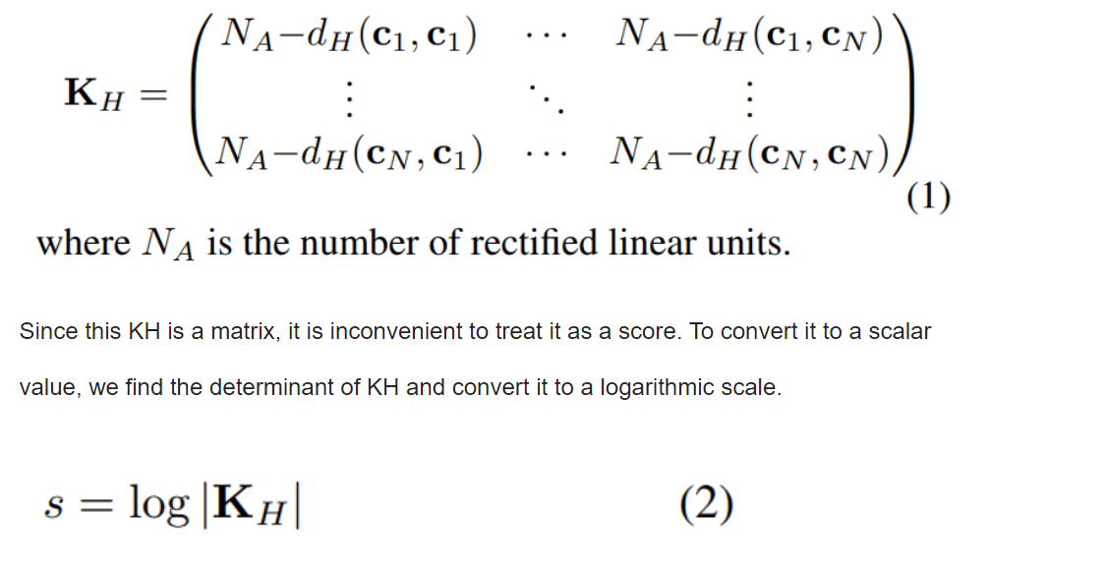
Training-free Metrics
Linear regions and NASWOT score

Slide 8
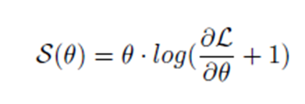
Training-free Metrics
NASWOT - Neural Architecture Search without Training
evaluates the expressiveness of an architecture;
a rapid assessment of its competitiveness in a matter of seconds
LogSynflow - Synaptic Flow
measures the importance of each neuron in the network by quantifying its contribution to the final prediction;
Synflow is designed to rank neural network models based on their saliency, which is computed by taking the derivative of the loss function with respect to model’s parameters

Slide 9
Hardware Constraints
Constraints
Number of Parameters -:The number of parameters refers to the total count of learnable parameters in a machine-learning model, indicating the complexity and storage requirements of the model.
Number of FLOPs -: FLOPs (Floating Point Operations) measure the computational complexity of a model, representing the number of floating-point arithmetic operations performed during the model's inference or training.
Optimization Problem: The goal is to optimize the models while staying within the specified hardware limitations.

Slide 10
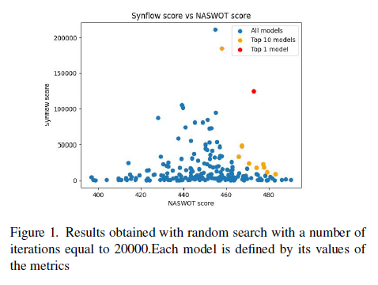
Random Search
Architectures are assessed based on specific criteria, such as Synflow score, NASWOT score, and parameters.
These metrics help evaluate the architectures' performance, computational efficiency, and parameter influence.
The architectures are ranked according to their metric values, enabling comparison and selection.
The evaluation criteria and metrics chosen depend on the project's objectives and evaluation requirements

Slide 11
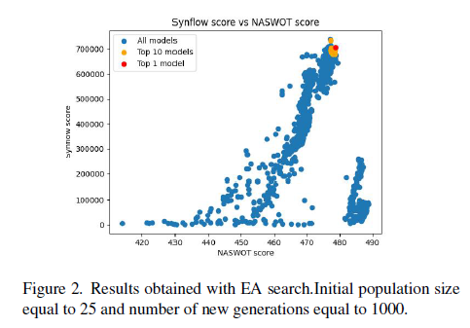
Evolutionary Search
The evolutionary algorithm guides the search for better models by emulating natural evolution.
It incorporates aging evolution, removing the oldest models, crossover to mix parent characteristics, and mutation operations.
The algorithm generates new architectures by adding, changing, or removing blocks.
Results are obtained through the evolutionary search process, with an initial population size of 25 models and 1000 generations.

Slide 12
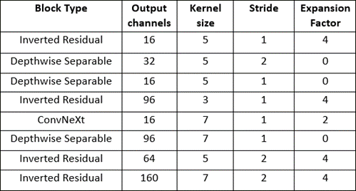
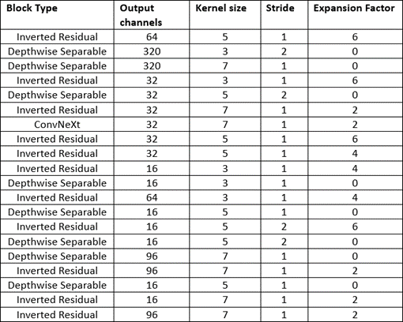
Architectures
○ We used a block based search space for both the Random search algorithm and EA search algorithm.
○ Output channels: Number of feature maps produced by each block, impacting model capacity.
○ Kernel size: Size of convolutional filter, affecting level of detail captured.
○ Stride: Step size of convolution operation, influencing spatial resolution.
○ Expansion factor: Controls channel increase/decrease, impacting model complexity.
Architectures obtained using Random Search and EA search algorithm

Slide 13
Results
 | Parameters | FLOPS | NASWOT | Synflow
Random search | 1.49 · 10⁵ | 1.90 · 10⁸ | 473.6 | 2.50 · 10⁵
Evolutionary algorithm | 1.94 · 10⁵ | 1.90 · 10⁸ | 478.0 | 7.05 · 10⁵
MobileNetV3 | 2.18 · 10⁵ | 1.74 · 10⁸ | 455.0 | 2.94 · 10⁵
Satisfying the Constraints -:
Hardware constraints: 200M FLOPS and 2.5M parameters
During training, the models undergo 40 Epochs and passes over the training dataset to learn patterns and improve their performance.
The SGD optimizer with a momentum of 0.9 is used to update the model's parameters, adjusting their values gradually for optimization.
The learning rate of 0.01 determines the size of the steps taken to update the parameters, while weight decay (1e-5) adds a penalty term to prevent overfitting by reducing parameter magnitudes.

Slide 14
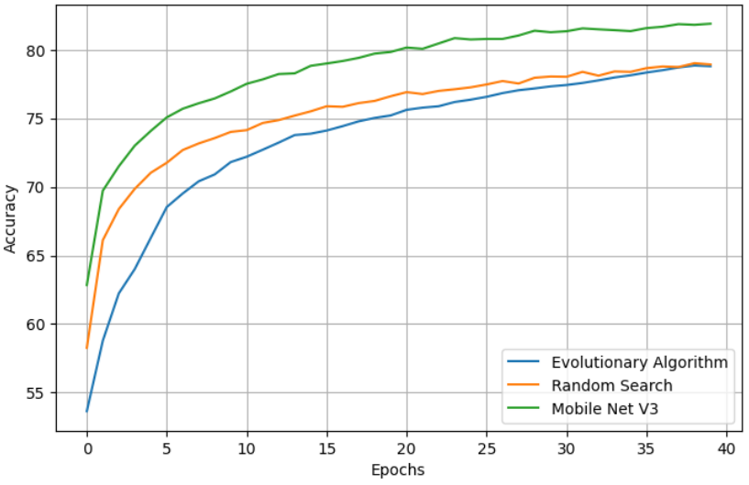
Results - Accuracy
Training accuracy
Test accuracy
Random search 83.81%
Evolutionary 80.68%
MobileNetV3 87.07%

Slide 15
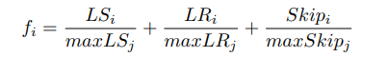
Fitness Function
The fitness function f for a certain model i is implemented as follows-: where J is the set of the investigated networks, LS is an acronym for LogSynflow, LR stands for Linear Regions, skip for Skipped layers
The fitness function is used to evaluate models based on metrics such as LogSynflow, NASWOT, FLOPS, and #Parameters. It aims to maximize efficiency while minimizing computational costs. Penalization and weighting are applied to prioritize efficiency and performance trade-offs.

Slide 16
Conclusion
We implemented different DNNs using NAS for the Visual Wake Words dataset respecting constraints of a TinyML scenario.
With training free metrics, we were able to select the best architectures in the proposed search spaces.

Slide 17
Thank You

